Slide 1
TagSwarm
Erik Sarson
SENG 564
November 9, 2018
https://github.com/sarsdawg/TagSwarm

Slide 2

TagSwarm Presentation Outline
Overview
Requirements
Design
Walkthrough
Known Issues
Future
https://github.com/sarsdawg/TagSwarm
Notes:
Picture: https://expanse.tech/wp-content/uploads/2018/03/roadmap2_icon-300x231.png

Slide 3


TagSwarm Overview
Help organizations crowdsource tasks involving geolocation
Infrastructure improvement
Disaster response
Crime solving
Create Tag with
GPS coordinates
Picture
Textual details
Android OS
https://github.com/sarsdawg/TagSwarm
Notes:
Pictures:
https://www.gannett-cdn.com/-mm-/e726fb3421c7be32eec6c8e4482552b304314100/c=0-0-512-288/local/-/media/2015/05/09/DetroitFreePress/B9317253302Z.1_20150509190017_000_GDAANUJ2A.1-0.jpg?width=3200&height=1680&fit=crop
https://www.efsa.europa.eu/sites/default/files/styles/home_page_large/public/news/crowd-source-171115.jpg?itok=1h-kmZcG

Slide 4

TagSwarm Requirements
Choose username
Create tag with geo-coordinates from GPS
Name the tag
Fill in tag details
Auto-associate unique device ID with tag
Auto-associate creation time with tag
Associate picture with tag from camera
Update tag
View list of tags and select from it
Native Android app
Direct install
No interference with normal phone ops
Prompt user to enable GPS
Limit size of pics
https://github.com/sarsdawg/TagSwarm
Notes:
Picture: http://www.windsor.edu/wp-content/uploads/2017/06/requirements.jpg

Slide 5
Design
https://github.com/sarsdawg/TagSwarm

Slide 6
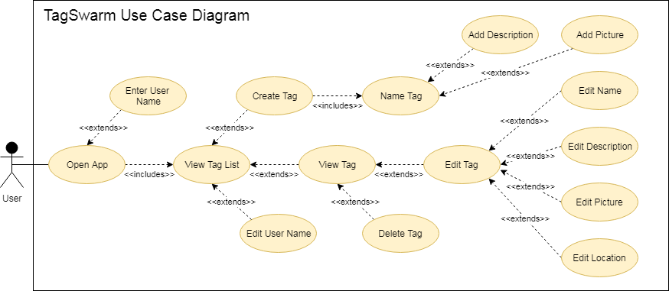
https://github.com/sarsdawg/TagSwarm

Slide 7
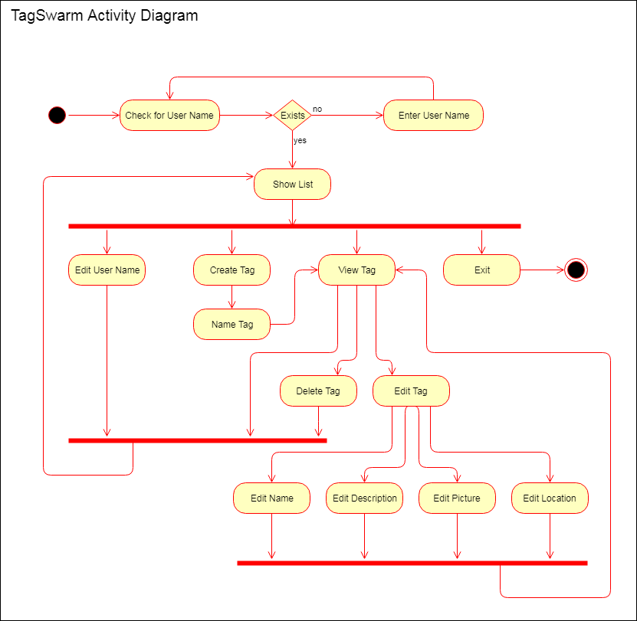

Slide 8
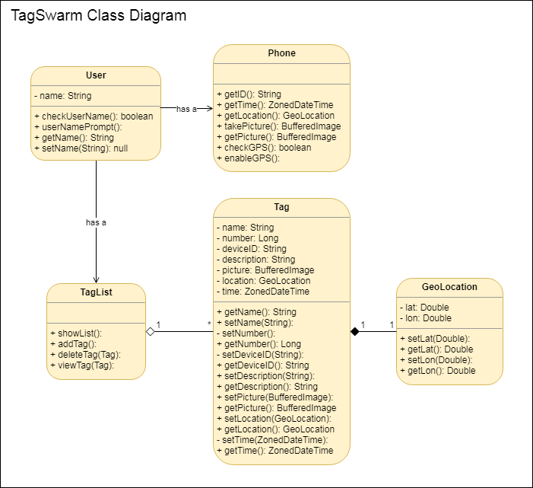
Initial hack at class diagram
Prior to good understanding of Android
Architecture
Design Patterns
DRASTICALLY changed in implementation

Slide 9
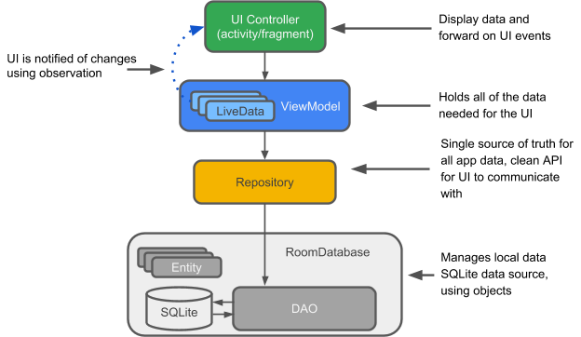
Android Room
Data persistence library
Wrapper for SQLite
Associated design pattern
Integrates with standard Android architecture components
Basis for TagSwarm design
https://github.com/sarsdawg/TagSwarm
Notes:
Picture: https://codelabs.developers.google.com/codelabs/android-room-with-a-view/img/3840395bfb3980b8.png

Slide 10
TagSwarm
Architecture
User
UserNameDialogFragment
MainActivity
TagListAdapter
GPSTracker
NewTagActivity
ViewTagActivity
EditTagActivity
Overlayed on Room architecture
Multiple activities and fragments for UI components
Adapter (TagListAdapter) for RecyclerView in MainActivity
LocationListener (GPSTracker) for separate GPS functionality
User singleton
TagViewModel
TagRepository
TagRoomDatabase
Tag
TagDao
https://github.com/sarsdawg/TagSwarm
Notes:
Picture: https://codelabs.developers.google.com/codelabs/android-room-with-a-view/img/3840395bfb3980b8.png

Slide 11
Walkthrough
https://github.com/sarsdawg/TagSwarm

Slide 12
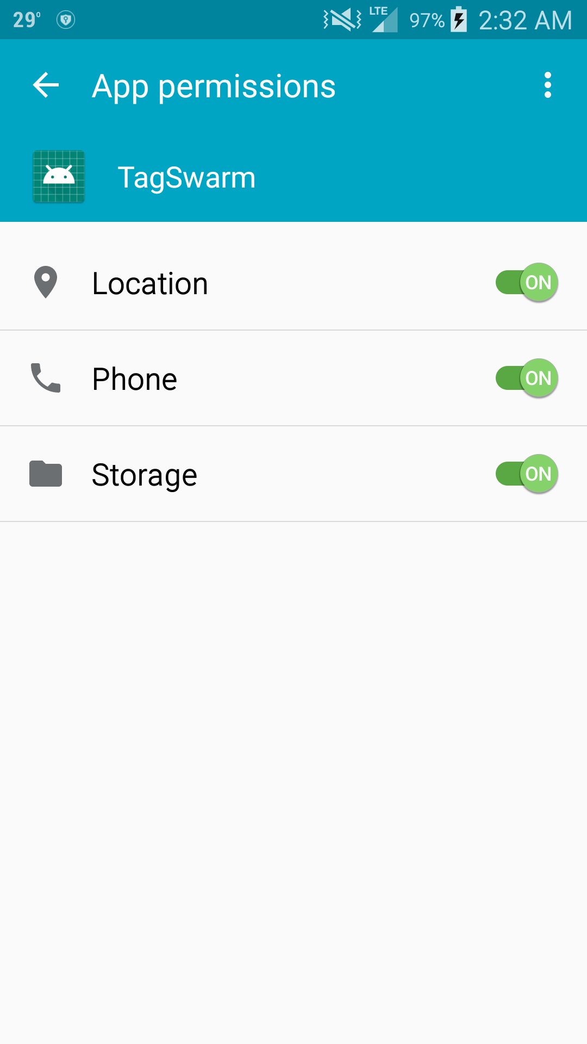
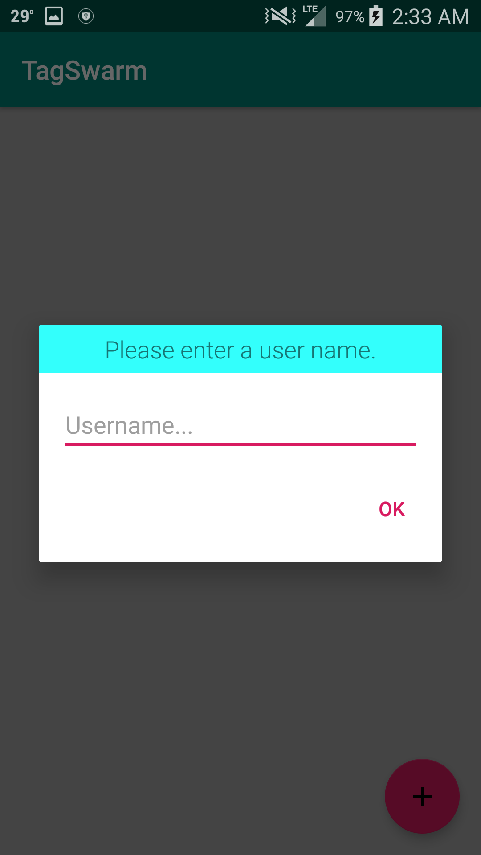
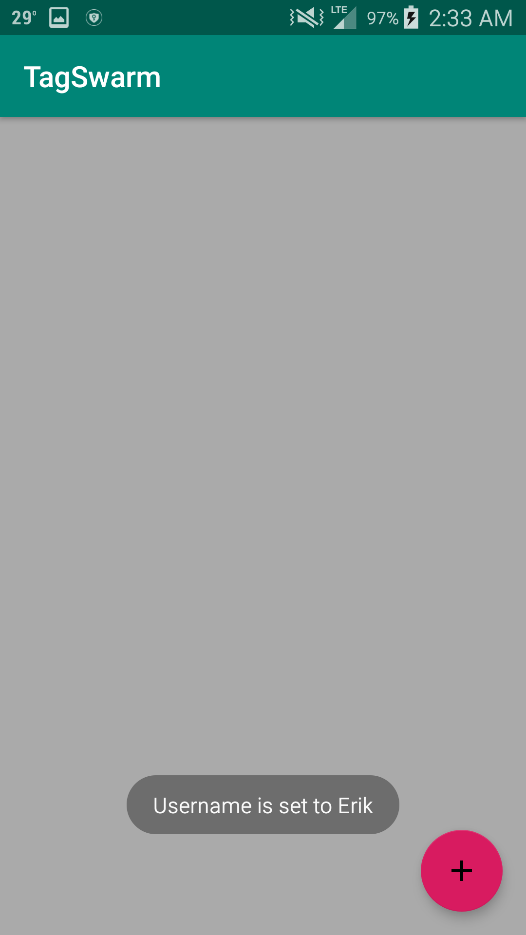

Slide 13
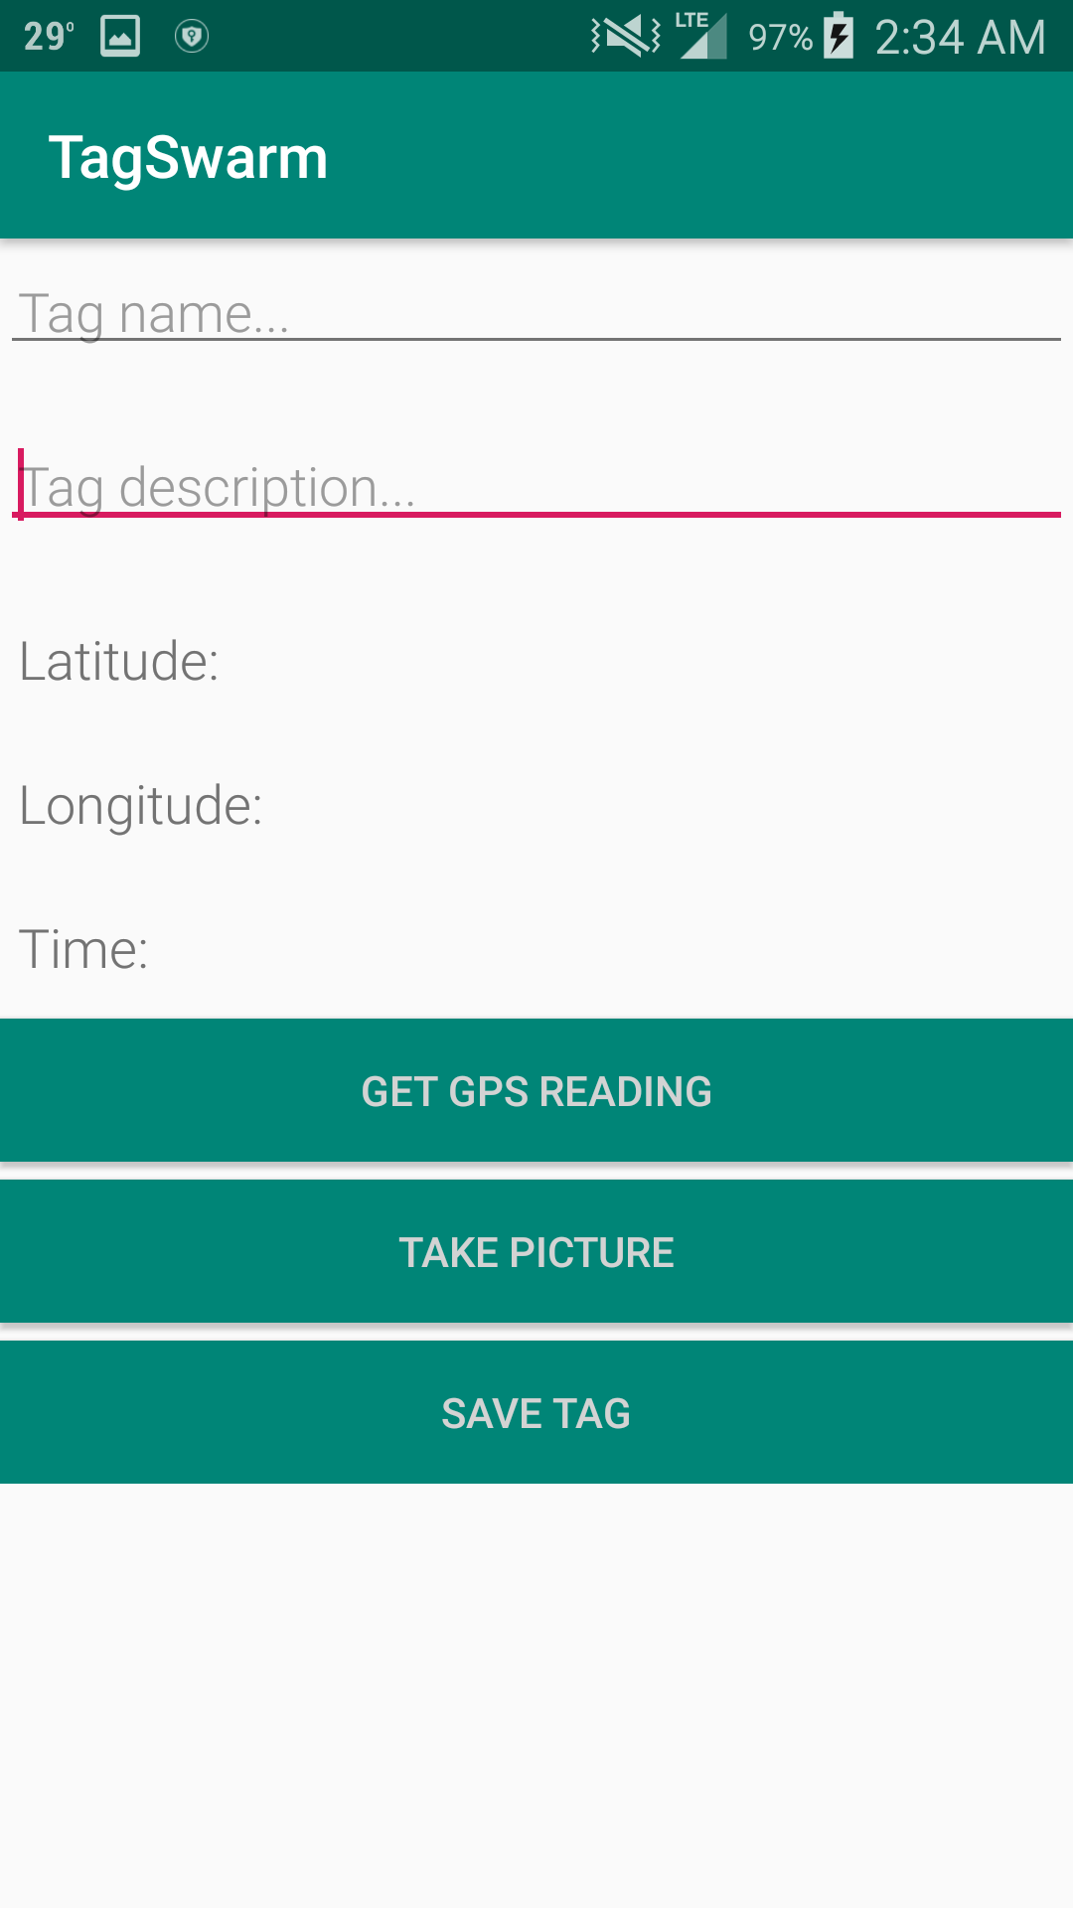
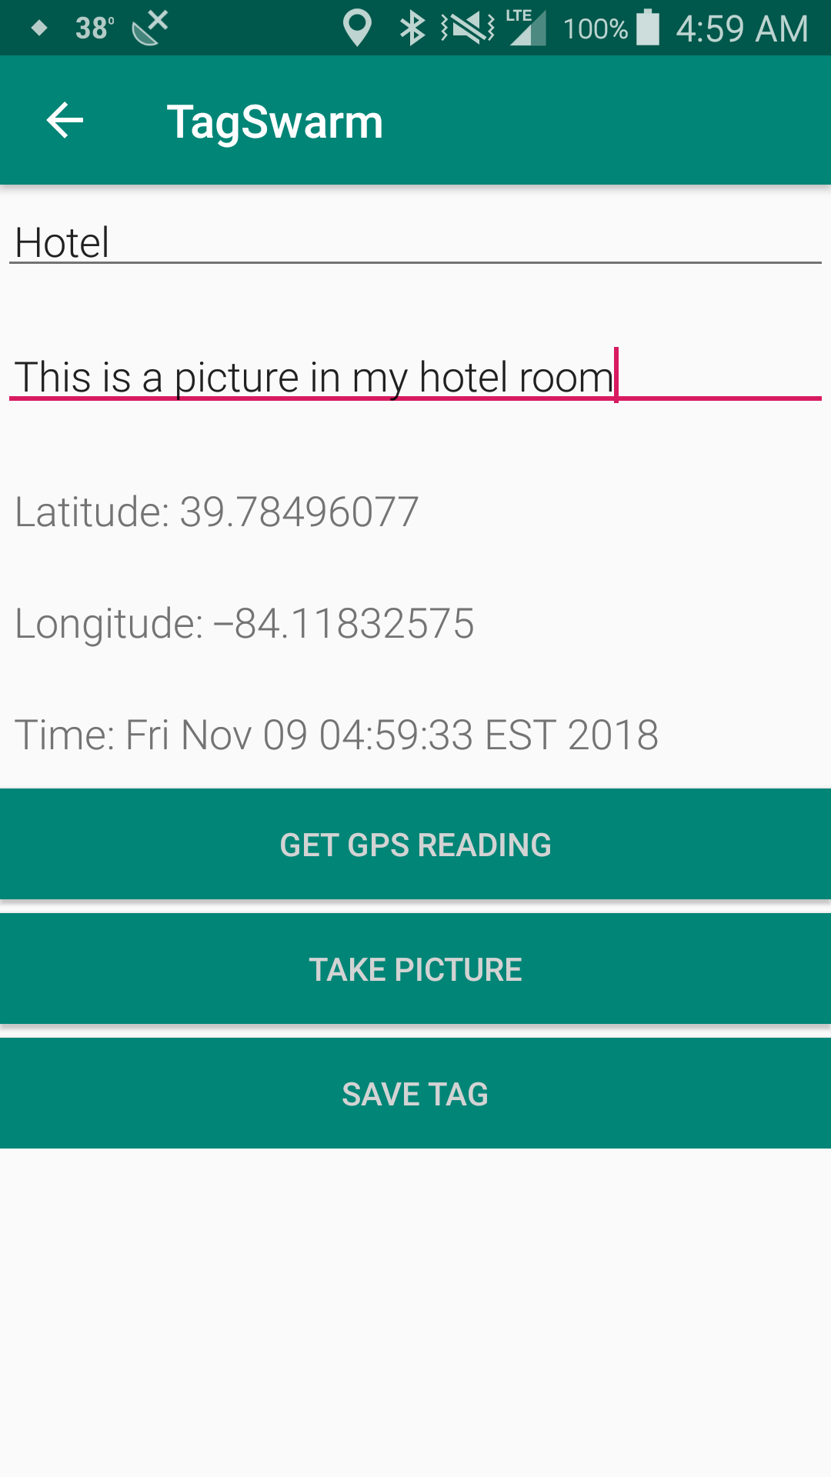
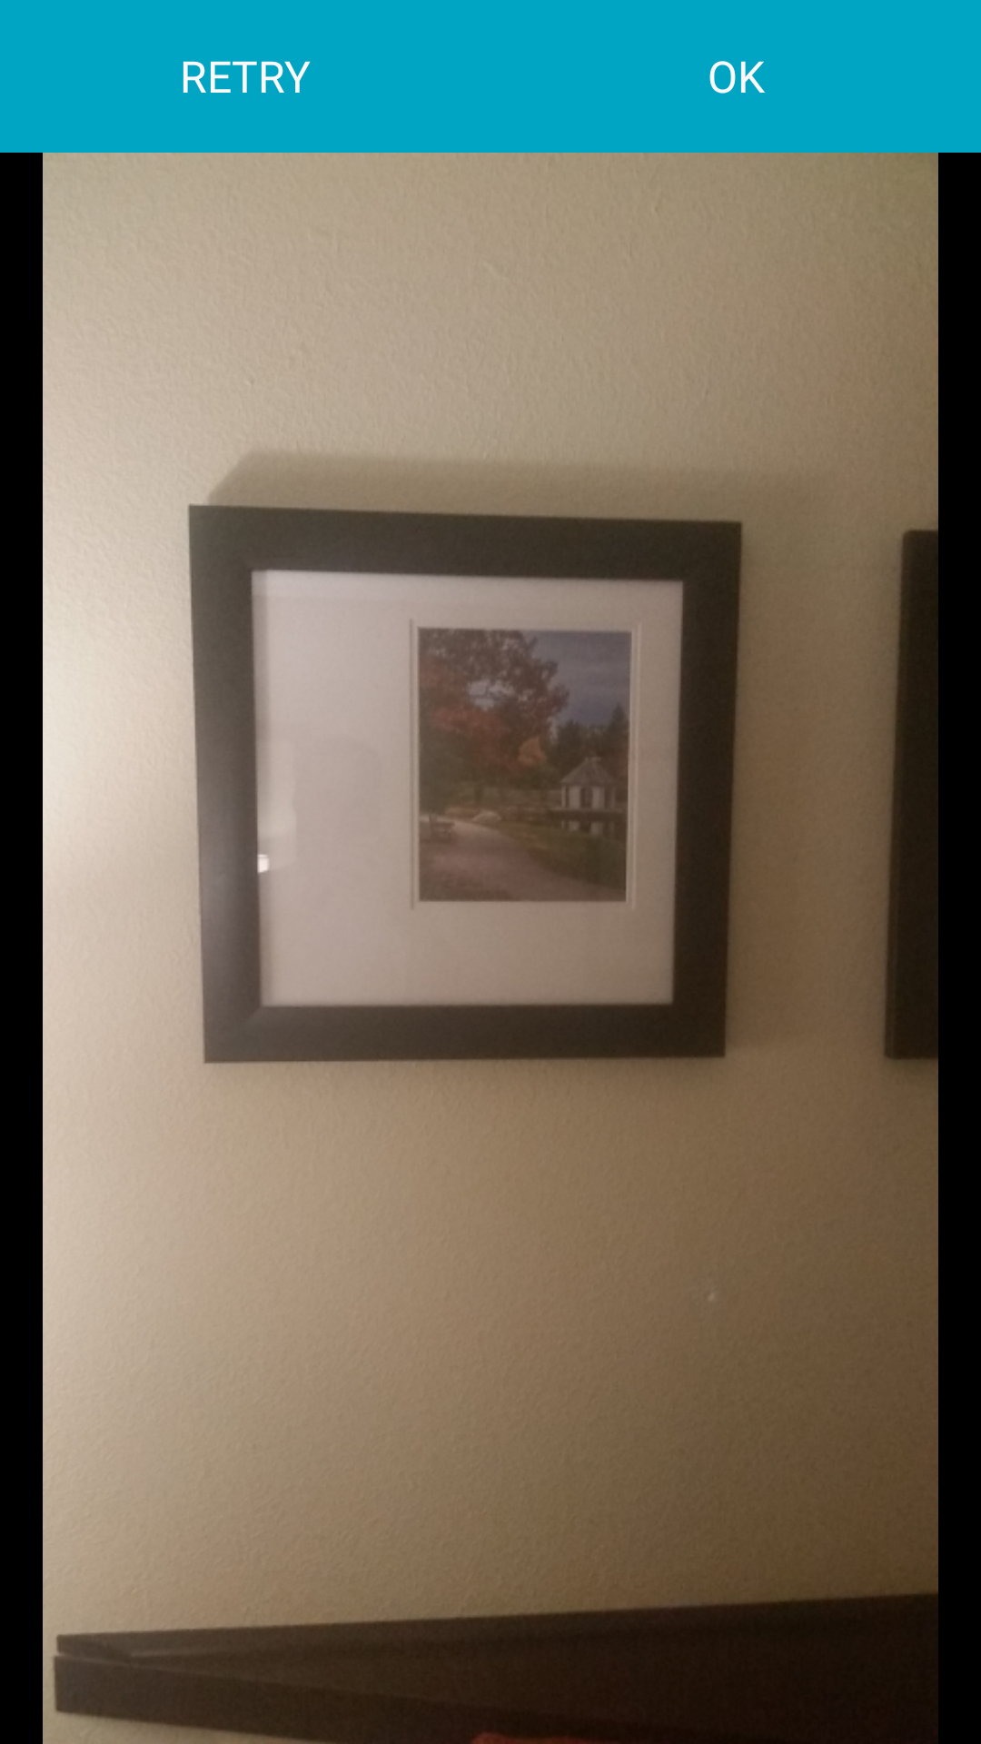
xxx
xxx

Slide 14
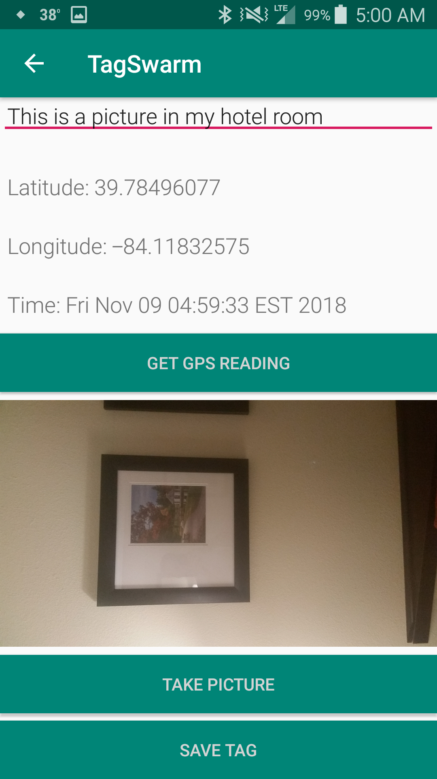
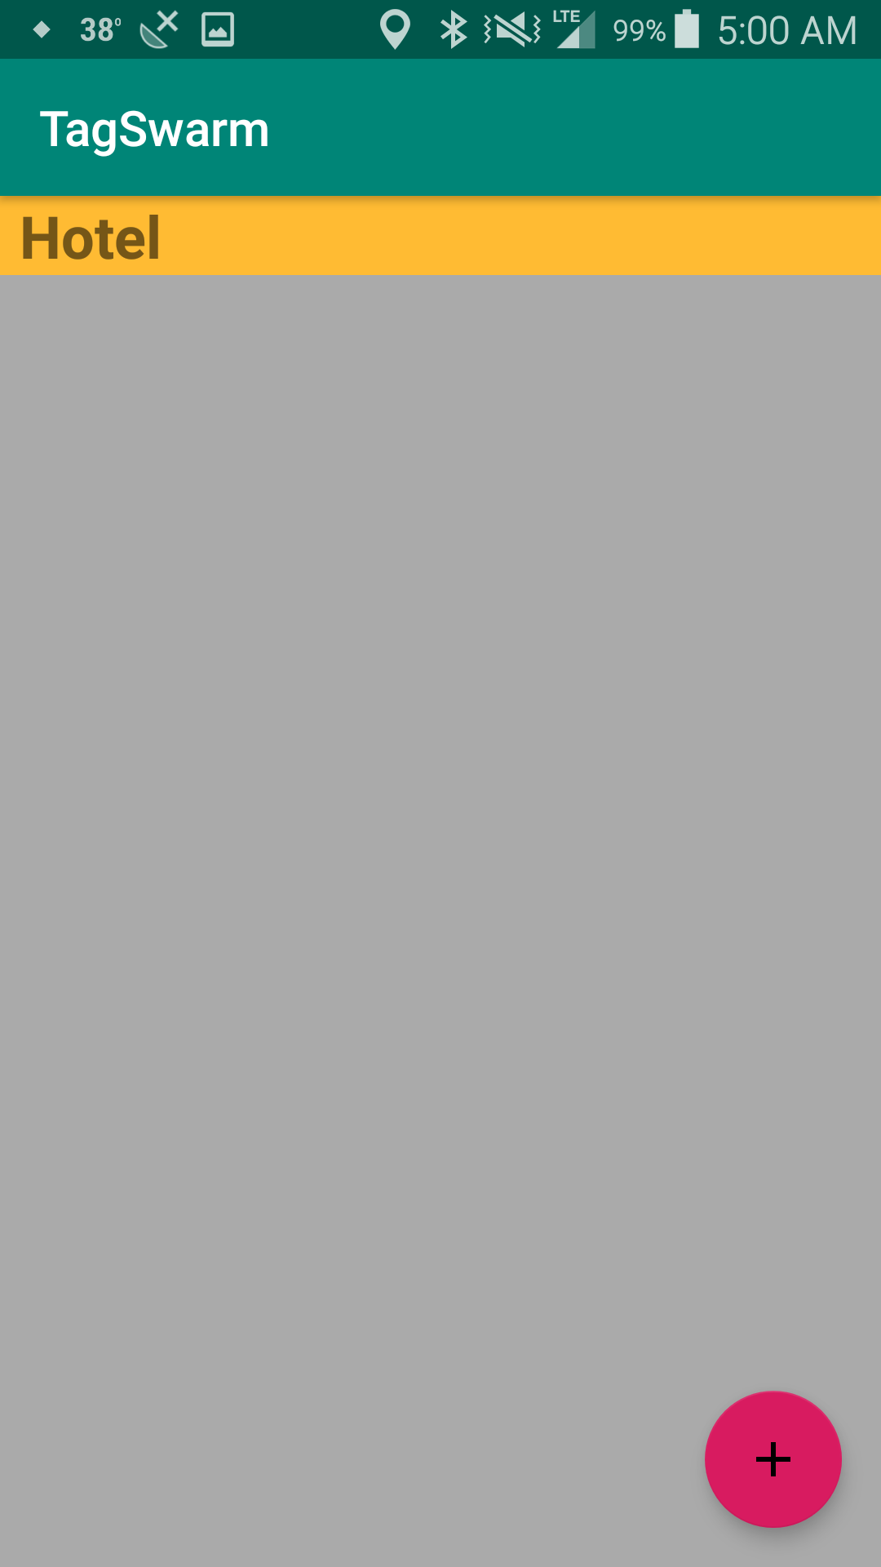
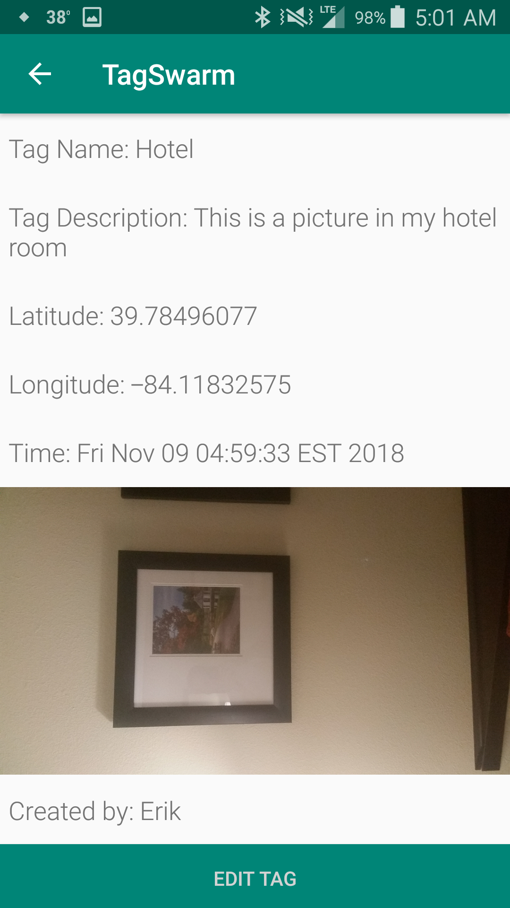

Slide 15
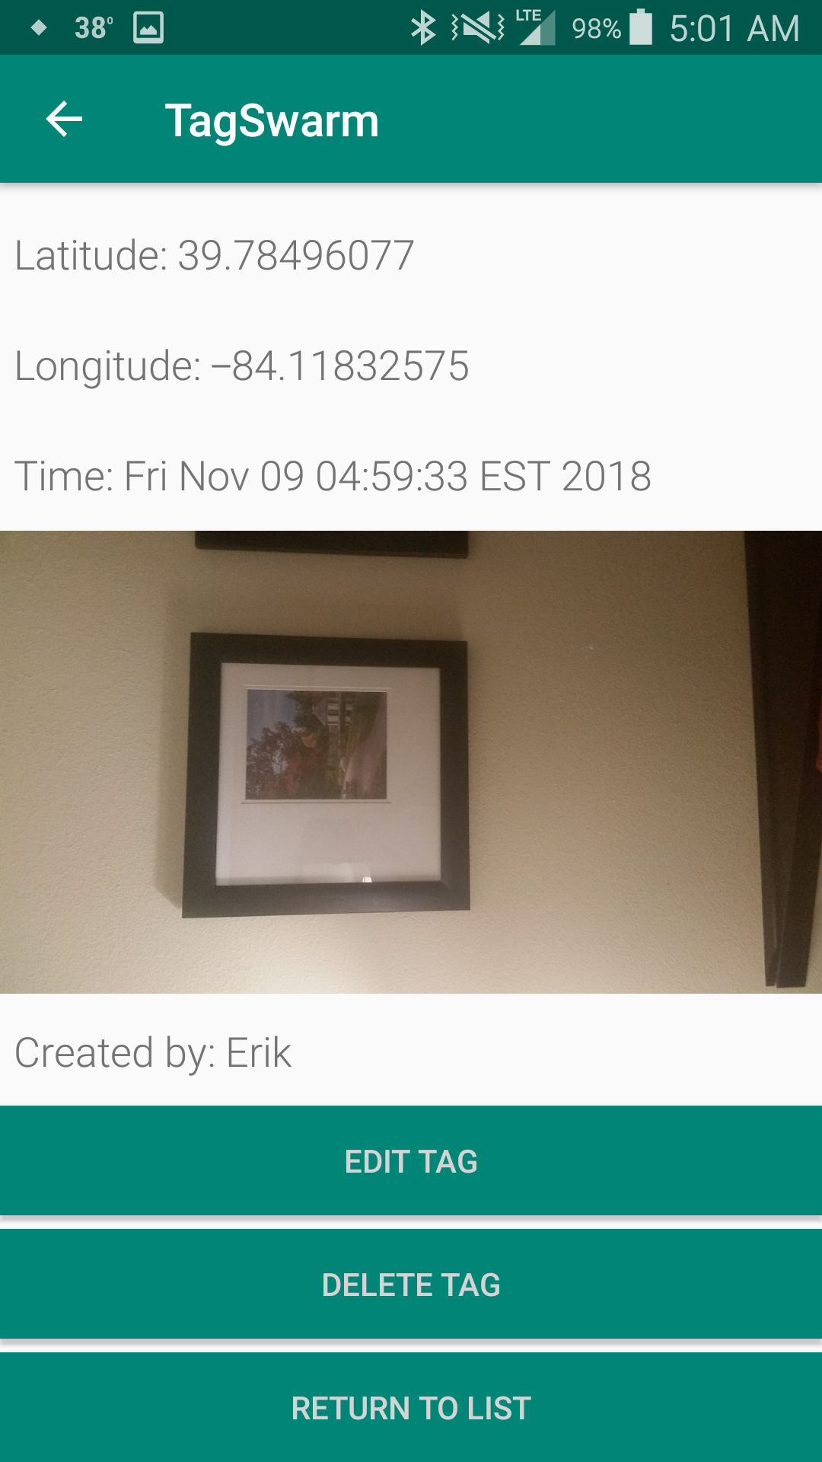
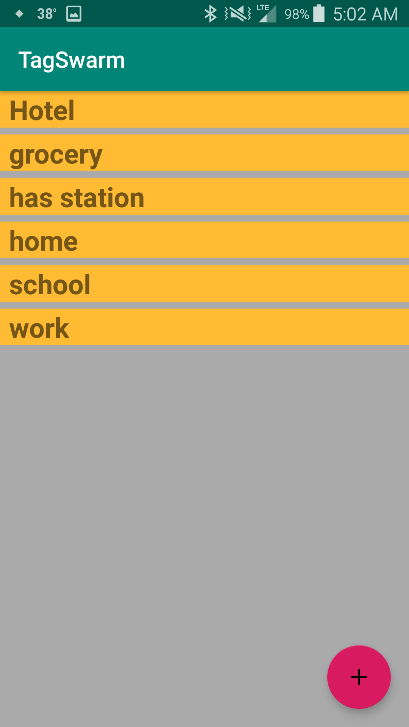
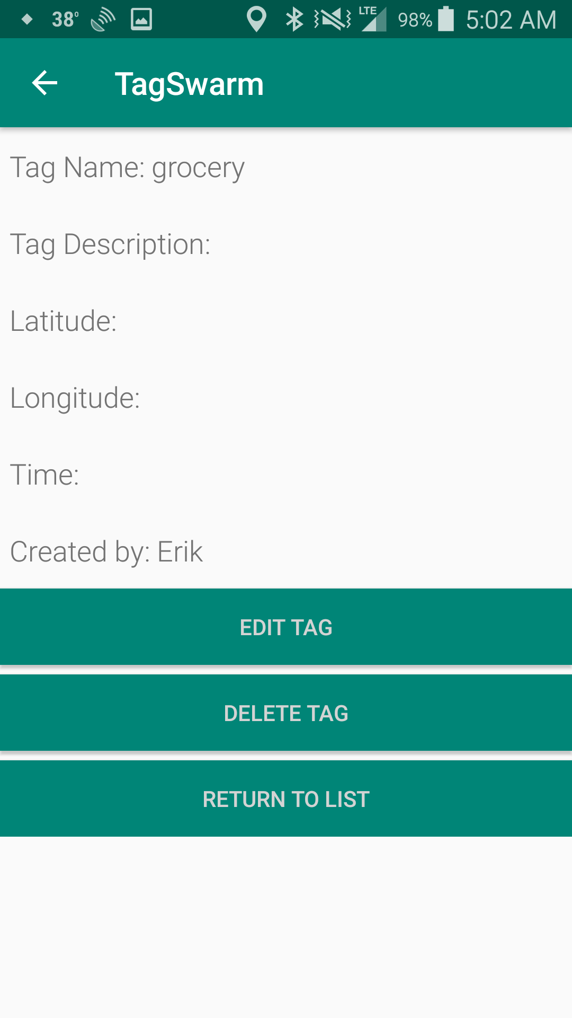

Slide 16
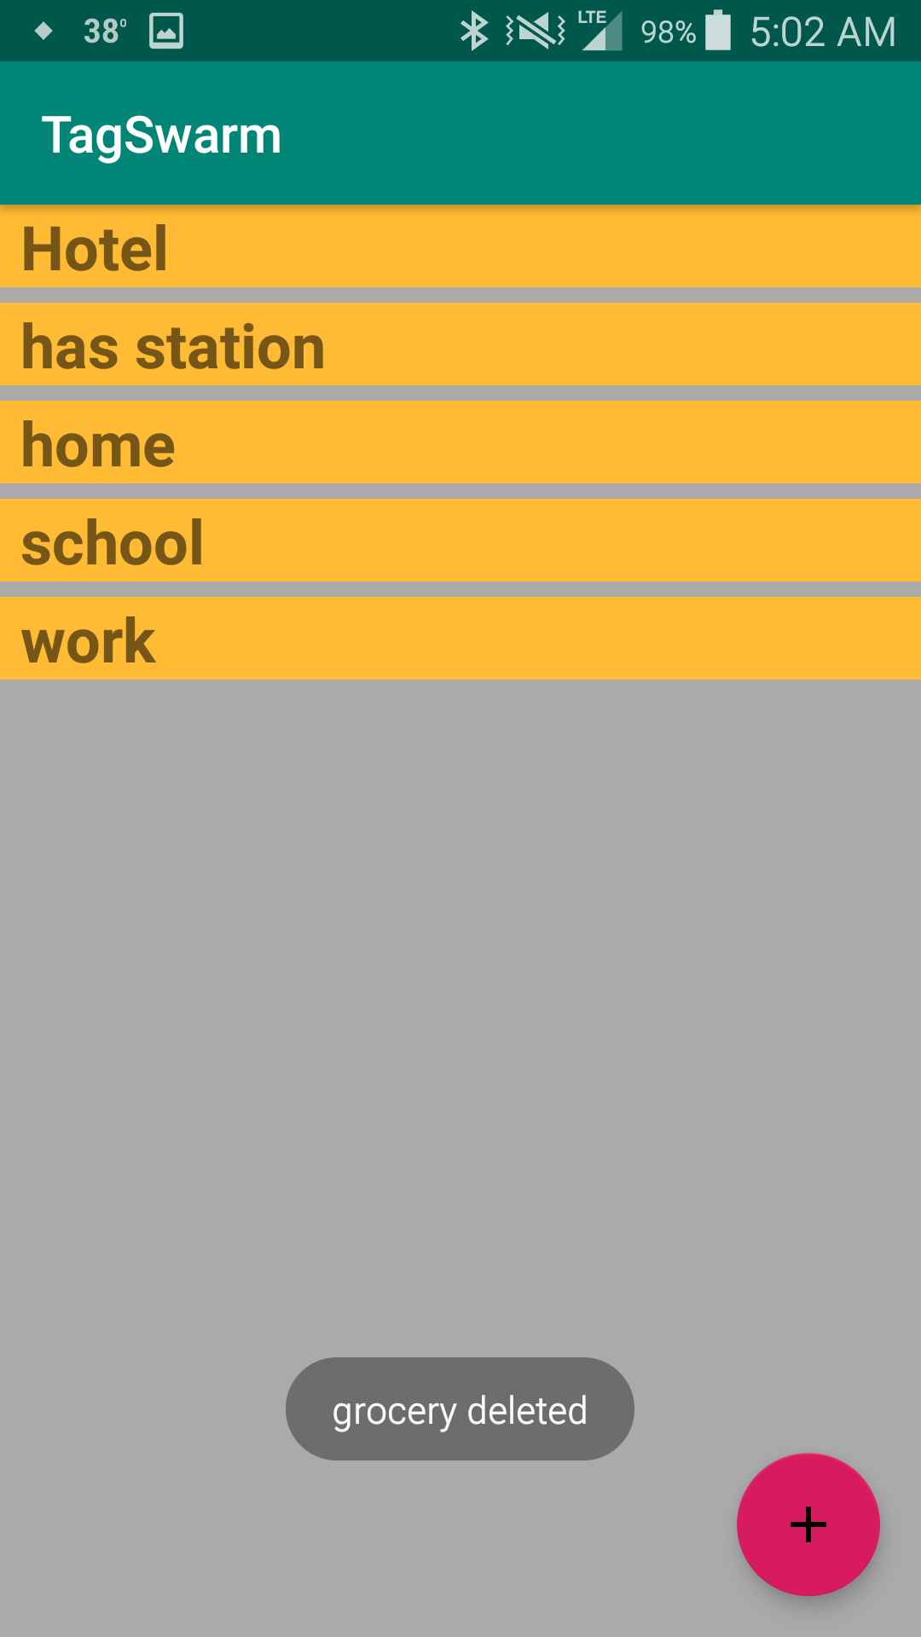
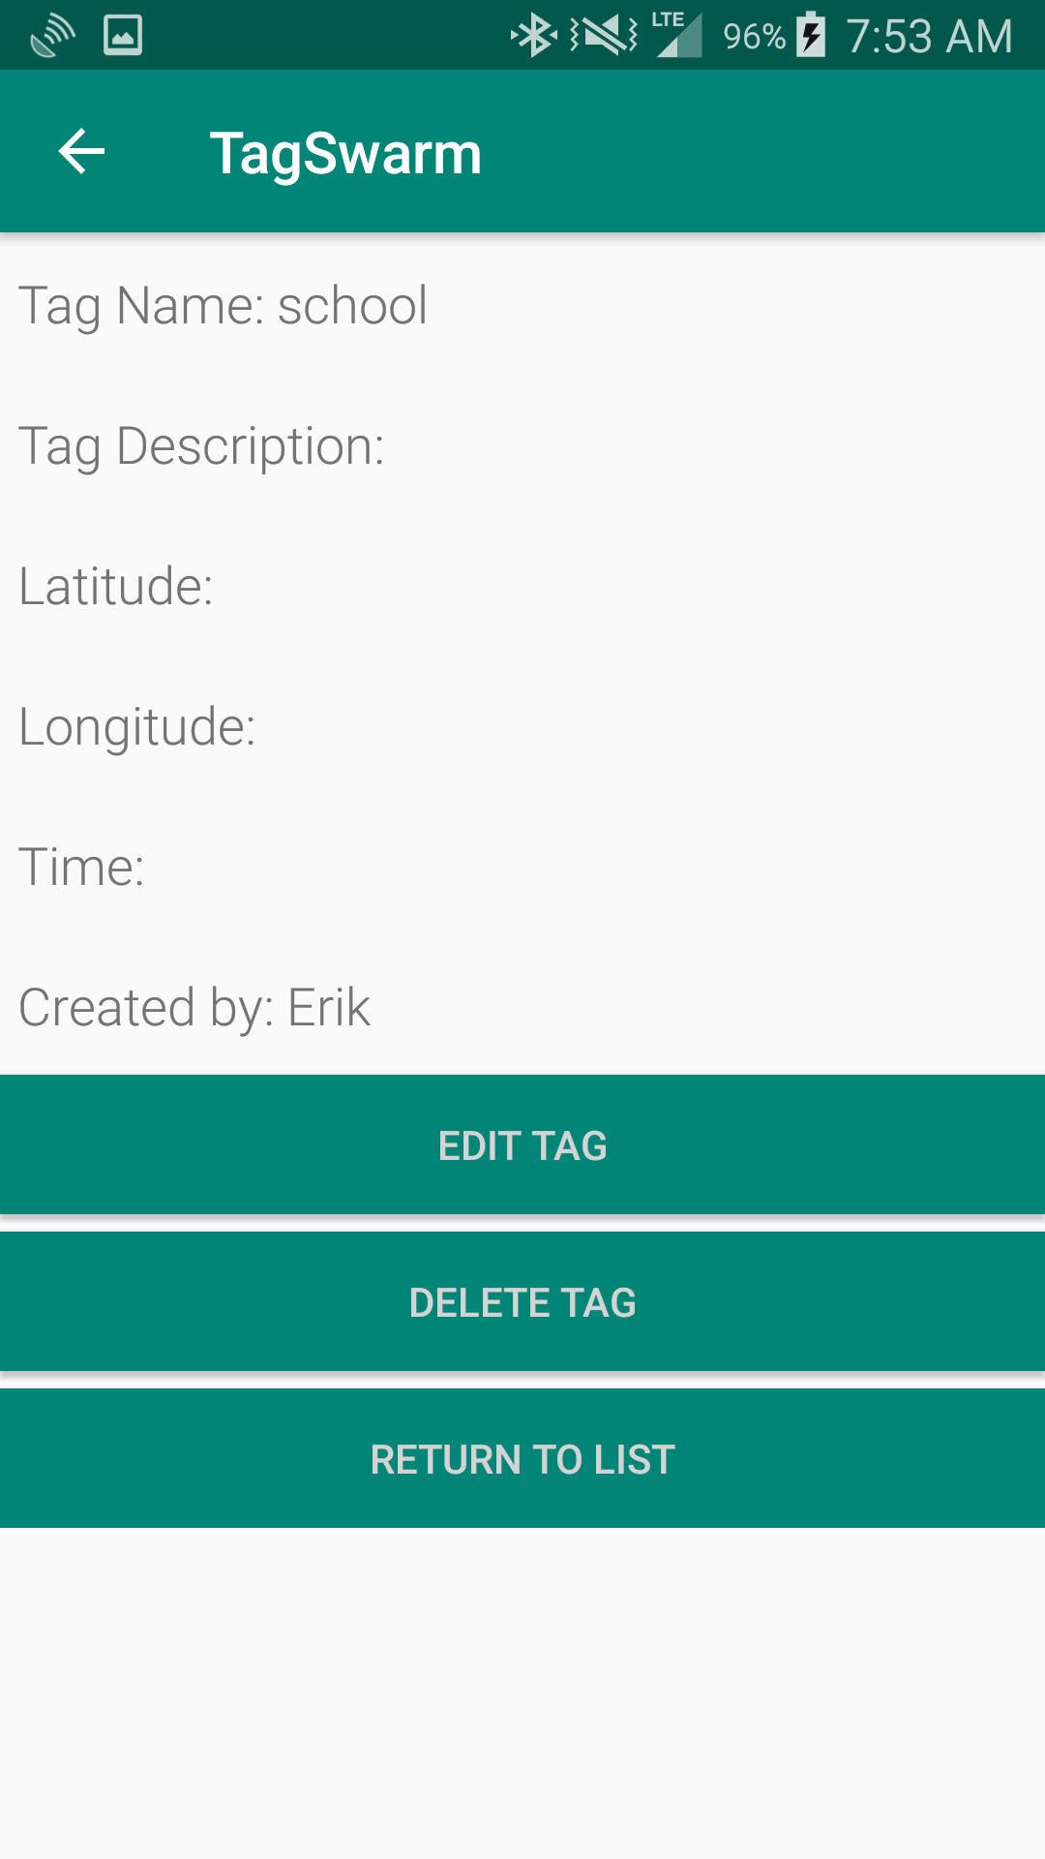
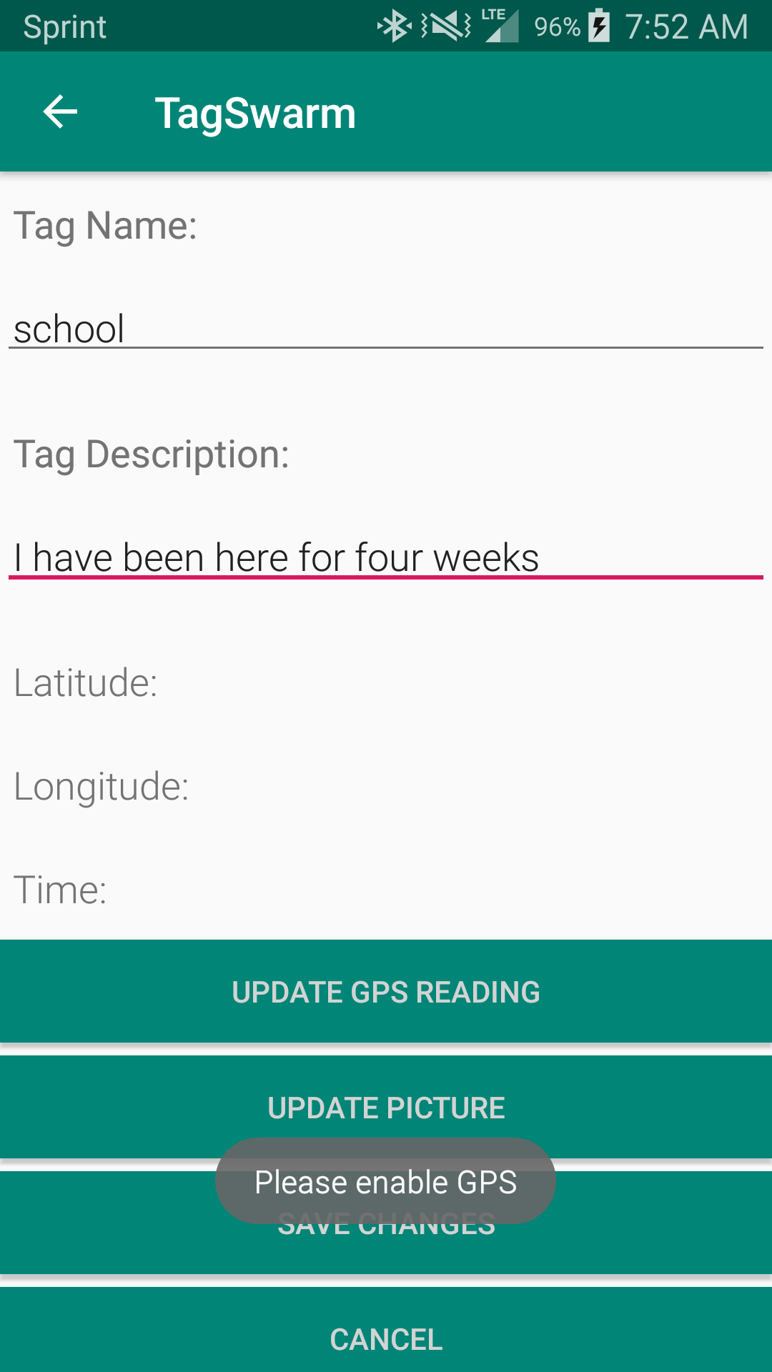

Slide 17
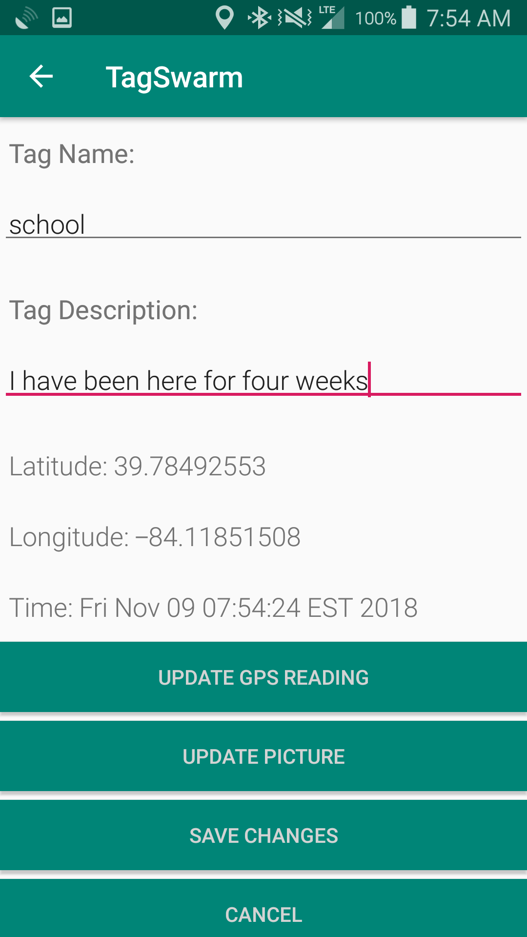
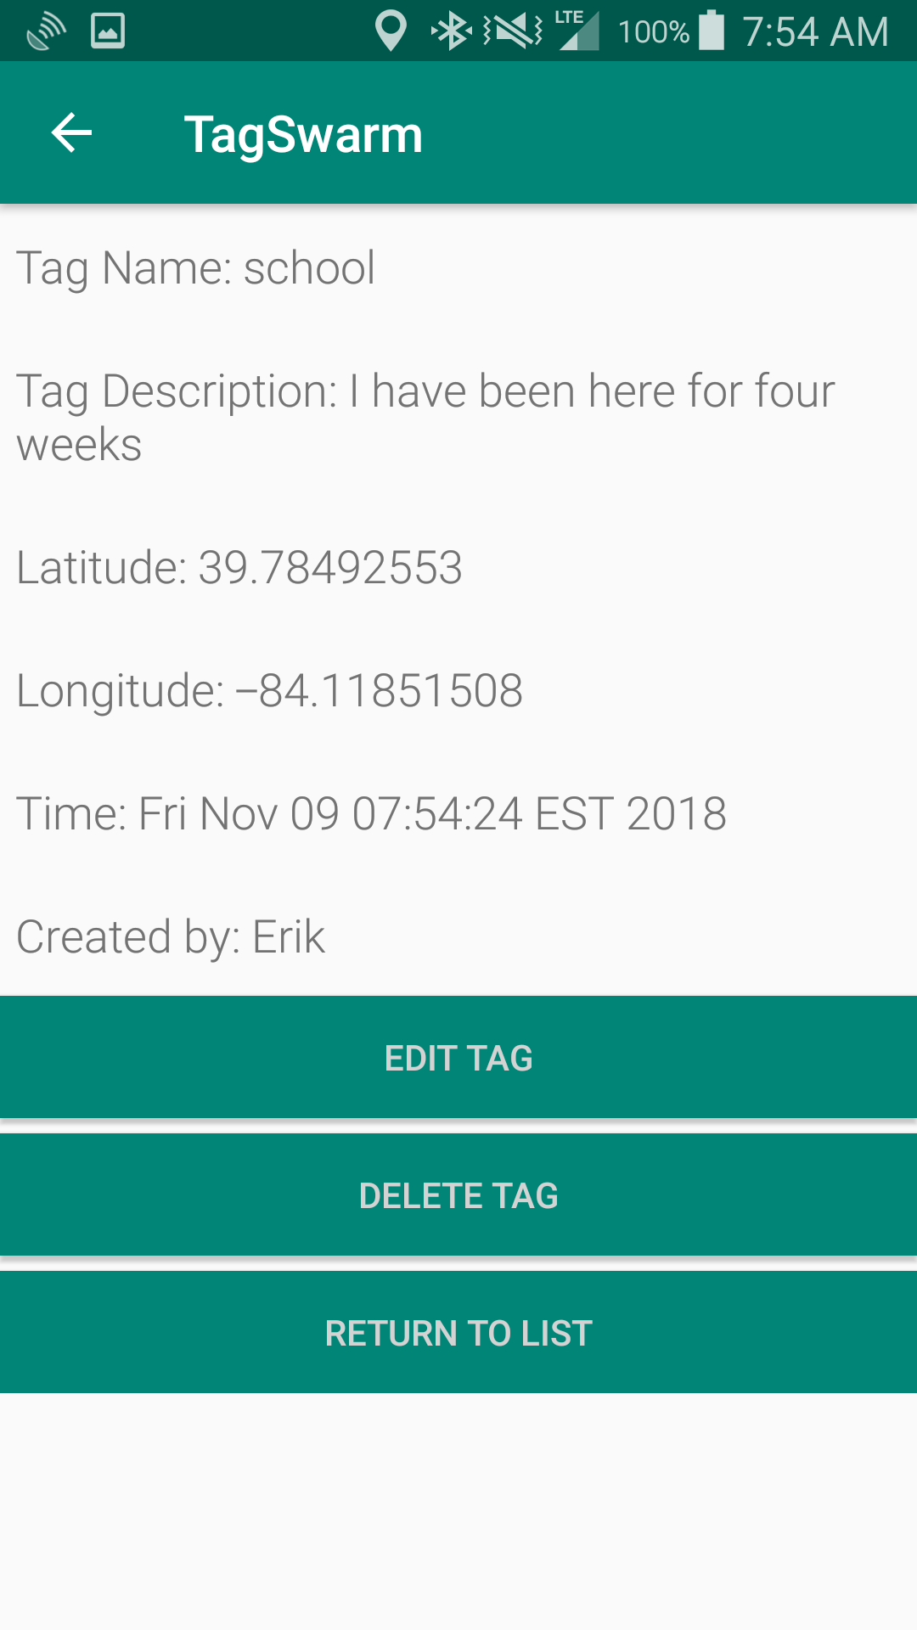
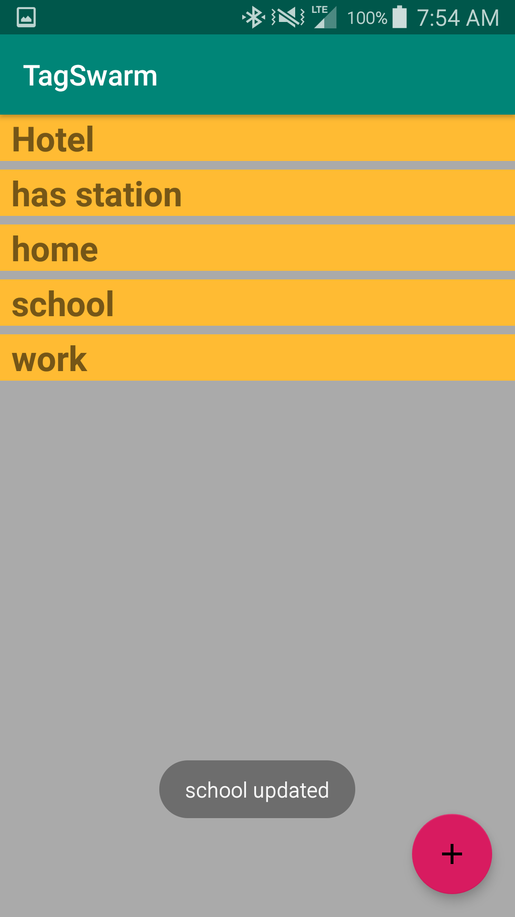

Slide 18
TagSwarm Known Issues
Able to bypass username entry
Persisting the username
Phone rotation
No confirmation dialog for deletion
Able to bypass saving updates with back button
No install prompting for location, phone, and storage permissions
https://github.com/sarsdawg/TagSwarm

Slide 19
Future TagSwarm Requirements
Map integration and tag selection
Synch with cloud DB
Admin view and update from web
Admin create user groups
Users join one or more user groups
Users see others’ tags in group
Users comment on others’ tags
Export .kml file for use in other mapping apps
Unique codes to join groups
Authentication
Core tag details only editable by creator and admin
Google Play Store distro
iOS App Store distro
Mobile website version with authentication
https://github.com/sarsdawg/TagSwarm

Slide 20

TagSwarm Presentation Summary
Overview
Requirements
Design
Walkthrough
Known Issues
Future
https://github.com/sarsdawg/TagSwarm
Notes:
Picture: https://blogs.cdc.gov/publichealthmatters/files/2016/12/iStock-475530175_banner.jpg

